Slide 1
BY: M.Aytac
In the healthcare industry, medical appointment “no-shows” are important problems that critically affect the business. Patients who fail to show up to scheduled appointments or cancel at the last minute - giving the health center no opportunity to fill the appointment slot - are often referred to as “no-shows”. In order to reduce the number of patient no-shows, it is essential to understand the potential factors causing the no-shows. This dataset consists of 110,524 medical appointments and 14 related variables (https://www.kaggle.com/joniarroba/noshowappointments). This dataset mainly focused on four key variables including gender, age, SMS (short message service) received, and no-show.

Slide 2
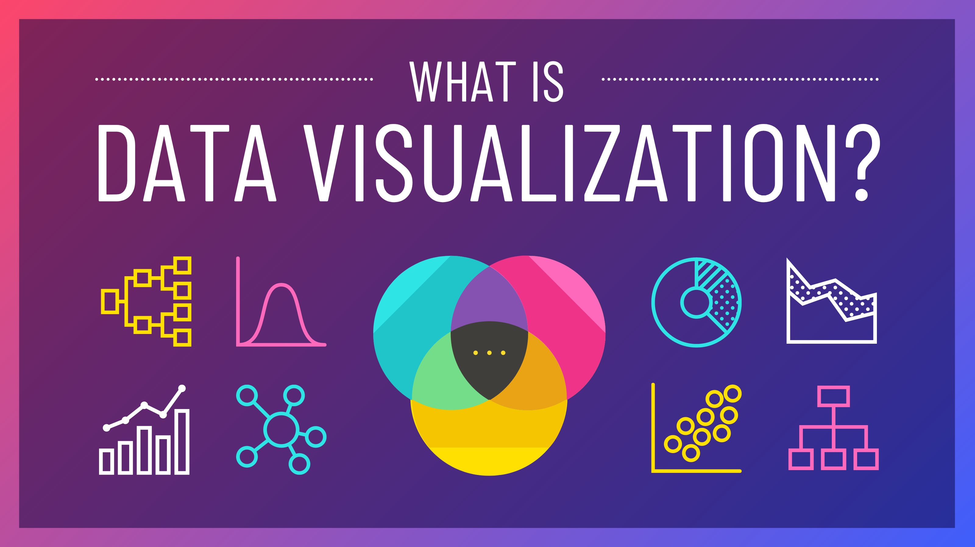
What is data visualization?
Data visualization is the graphical representation of information and data. By using visual elements like charts, graphs, and maps, data visualization tools provide an accessible way to see and understand trends, outliers, and patterns in data. Data Visualization is a process of taking raw data and transforming it into graphical or pictorial representations such as charts, graphs, diagrams, pictures, and videos which explain the data and allow you to gain insights from it. So, users can quickly analyze the data and prepare reports to make business decisions effectively.
In the world of Big Data, data visualization tools and technologies are essential to analyze massive amounts of information and make data-driven decisions.

Slide 3
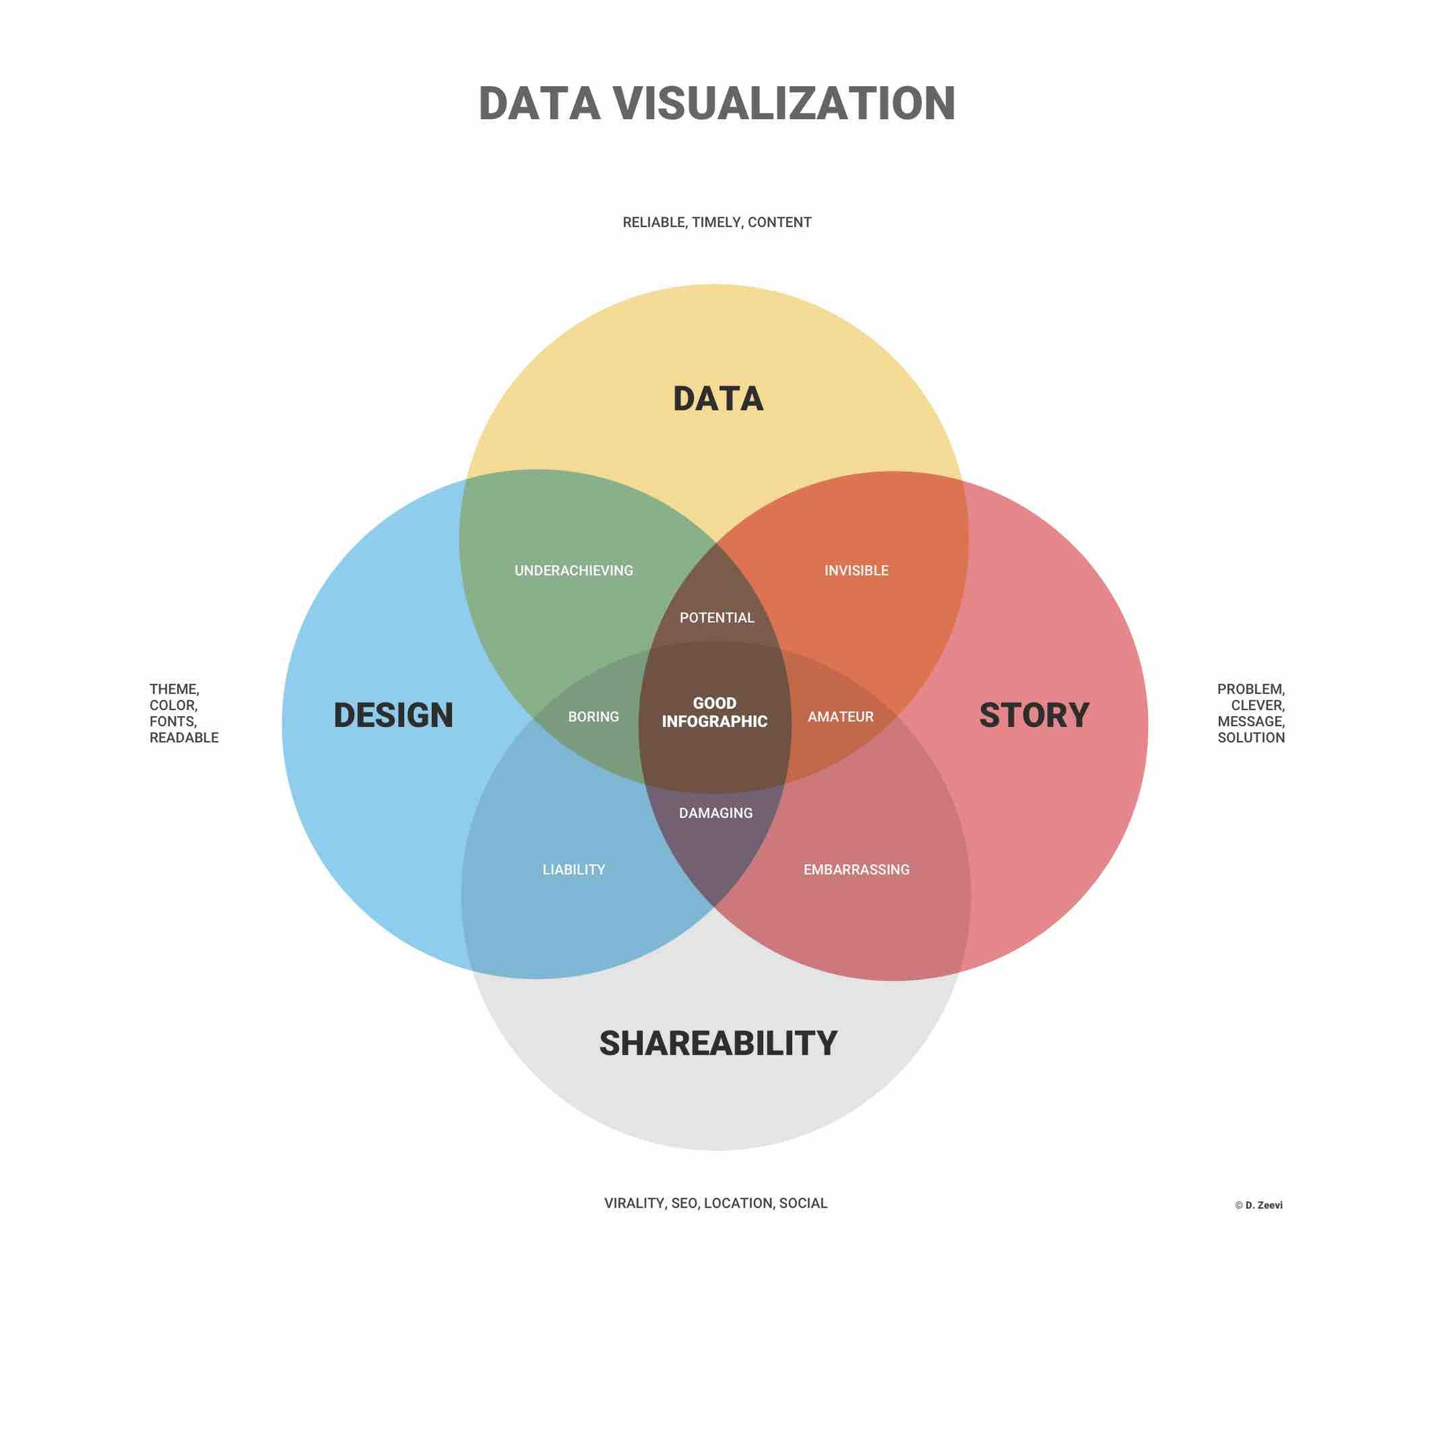
Importance of Data Visualization
We are inherently in the visual world where pictures or images speak more than words. So it is easy to visualize a large amount of data using graphs and charts than depending on reports or spreadsheets.
Data visualization is a quick and easy way to convey concepts to the end-users, and you can do experiments with different scenarios by making slight changes. It can also:
Clarifies which element influences customer behaviour.
Identifies the area to which you need to pay attention.
Guides you to understand which product should be placed in which location.
Predicts the sales volume.
The better you visualize your points, the better you can leverage the information to the end-users.

Slide 4
What are the advantages and disadvantages of data visualization?
Some other advantages of data visualization include:
Easily sharing information.
Interactively explore opportunities.
Visualize patterns and relationships.
Some other disadvantages include:
Biased or inaccurate information.
Correlation doesn’t always mean causation.
Core messages can get lost in translation.

Slide 5

Data Visualization Types Benefits and Features of Tableau
Tableau is an industry leader in the field of business intelligence. It is becoming the standard for data visualization. Now let’s see the important features of Tableau that are intuitive and powerful.
1. The visual analysis in a click
2. Interactive dashboard
3. Easy use
4. Direct connection
5. Deals with big data
6. Publishing and sharing
7. Deals with all types of data
8. Trending in the market
9. Interactive visualizations
10. Smart Maps
11. Works across multiple platforms
12. Copying between dashboards
13. Metadata Management

Slide 6
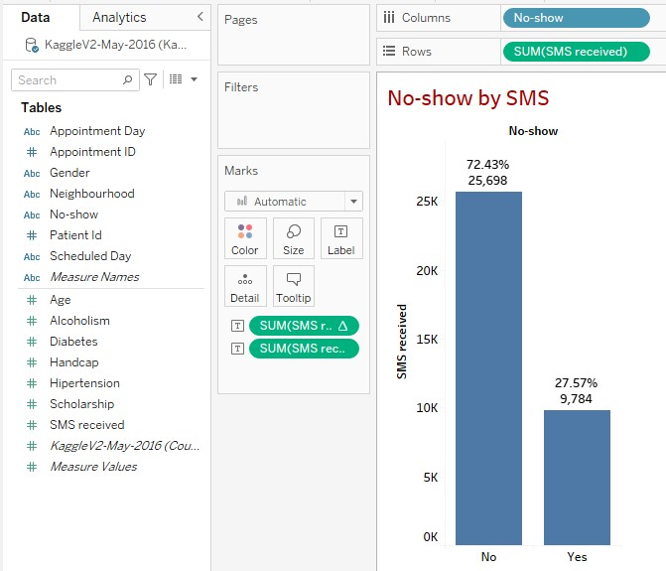
1) Does SMS help to reduce the number of patient no-shows?
We did the relation between no shows and SMS that the result shows that there is no any impact on in the graph you can see that the left side is higher then right side .
So the percentage of yes is 72.43, and the percentage of no is 27.57.

Slide 7
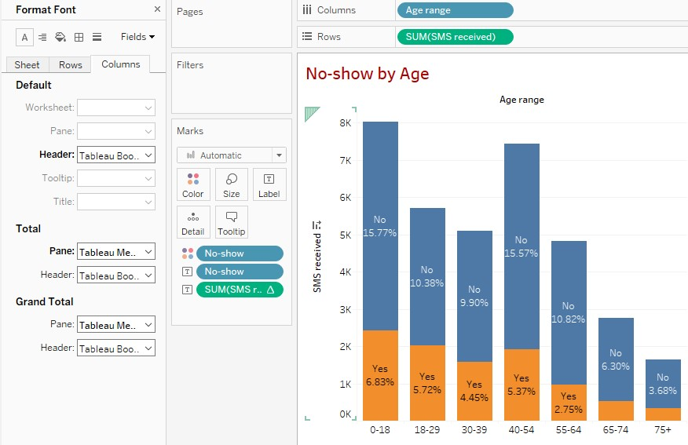
2) Is the pattern of no-show different by age?
If we keep looking at exactly to the graph,it says us that there isn’t any pattern by influencing from age range.(Mostly no answers)

Slide 8
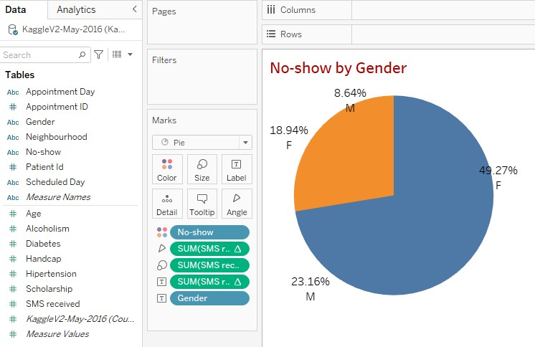
3) Is the characteristics of no-show affected by gender?
In this pie chart we can see that genders are effected by no-shows.We are able to notice that genders are essential

Slide 9
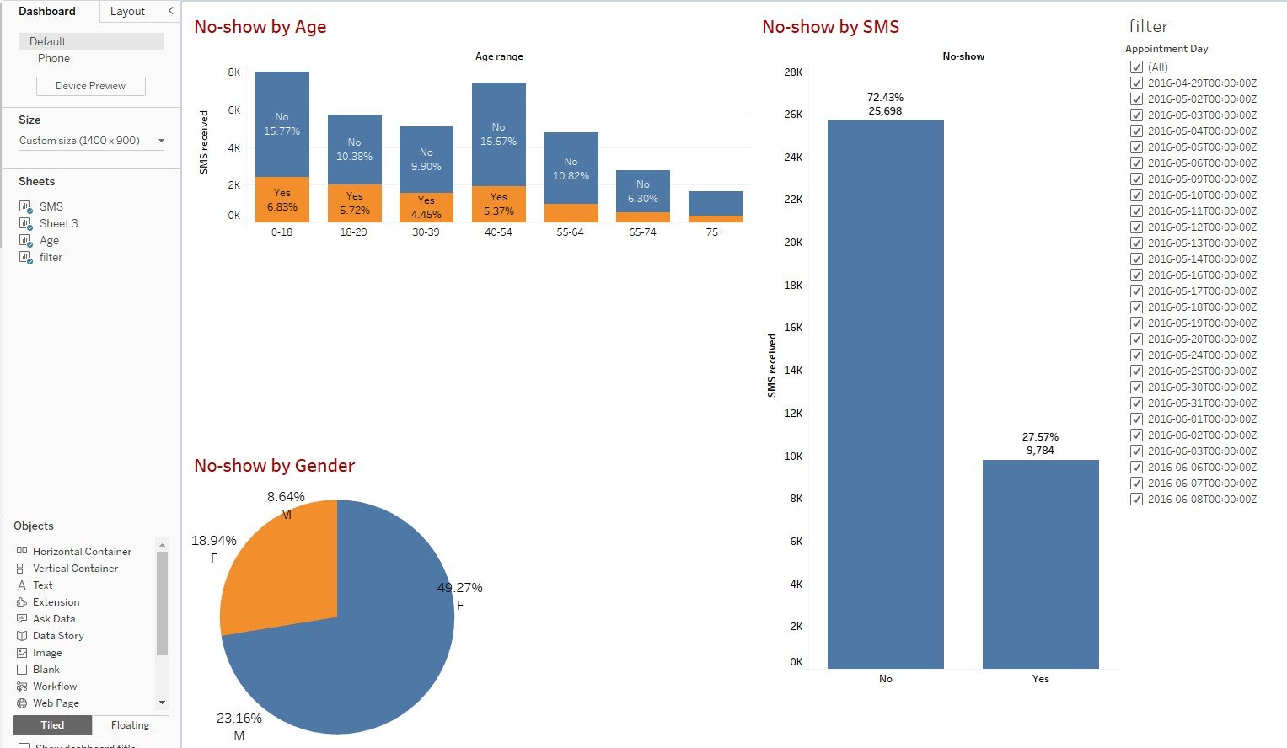
Our dashboard is described below.

Slide 10

Thank you for your attention!☺

